Slide 1
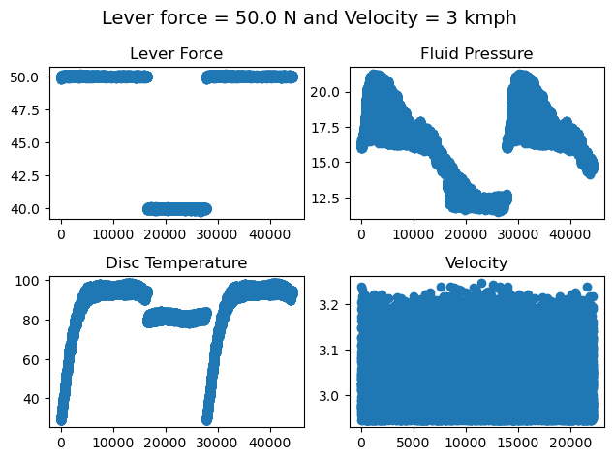
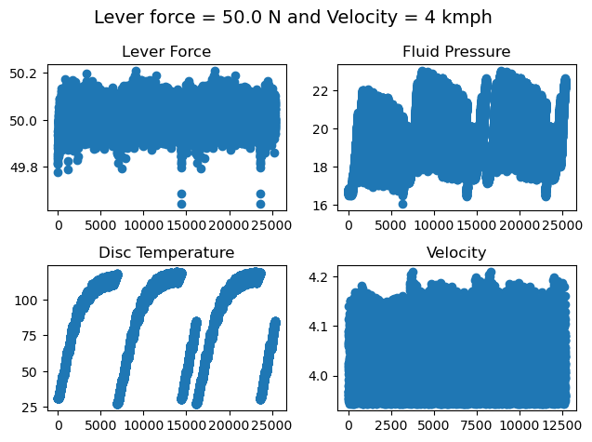
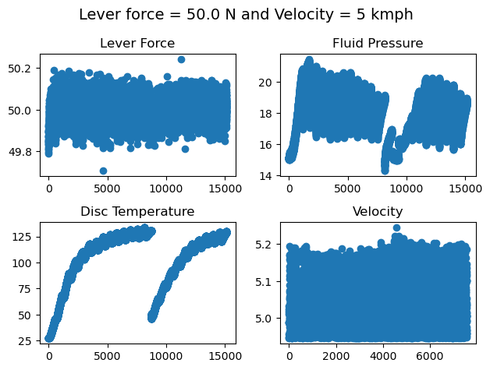
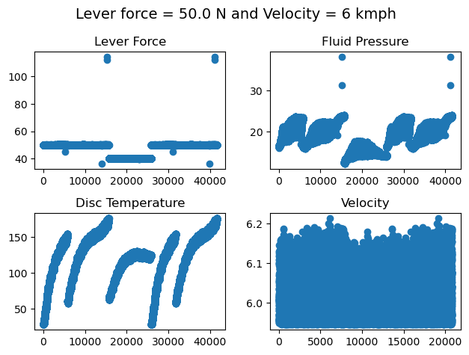
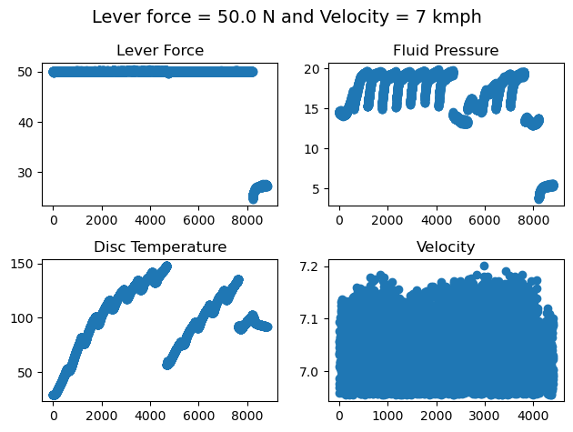
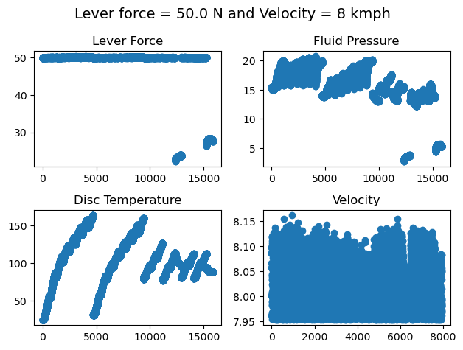
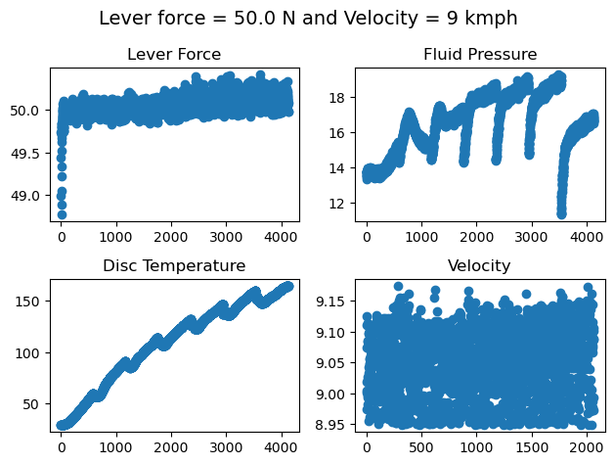
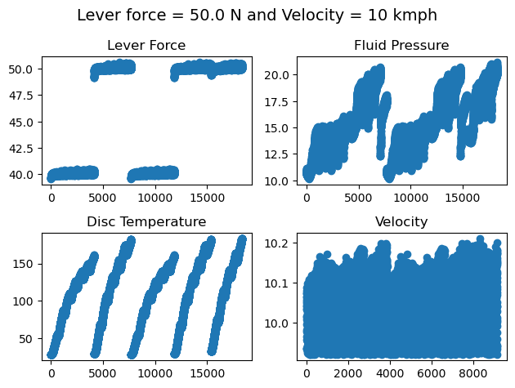
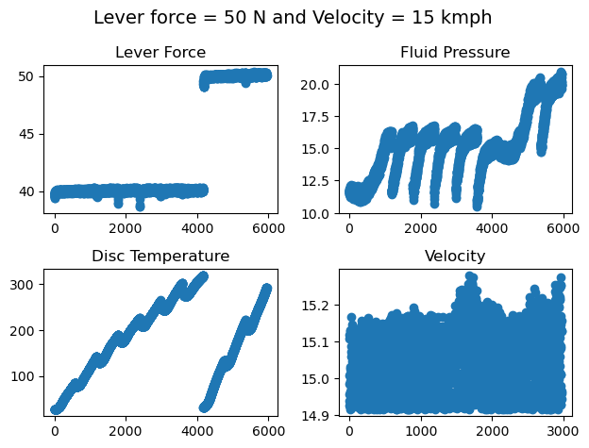
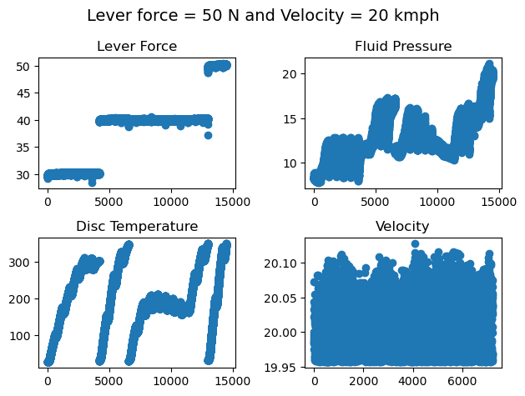
Transient data was plotted to understand the possible cause for variation of friction coefficient
Multiple temperature cycles are run. But they are not consistent
Lever Force is not consistent during experiment
Pressure sensor was off for 1 and 2kmph. Thus readings were not recorded for the case

Slide 2
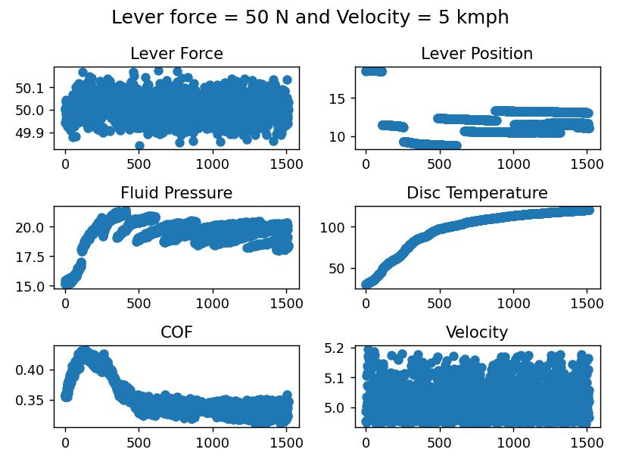
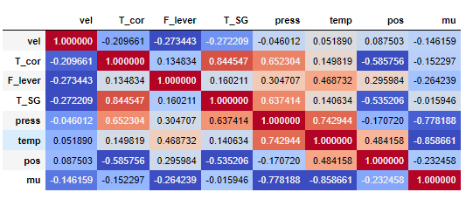
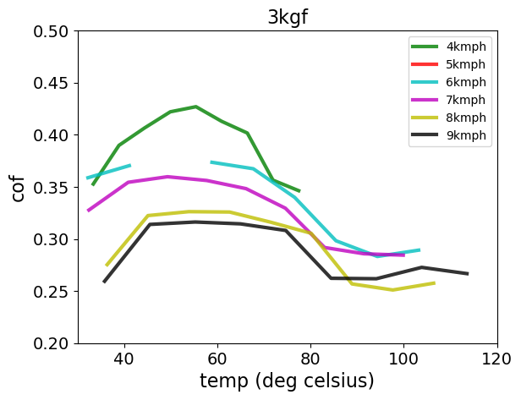
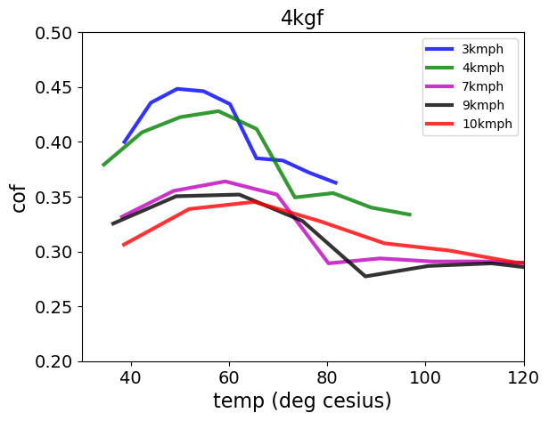
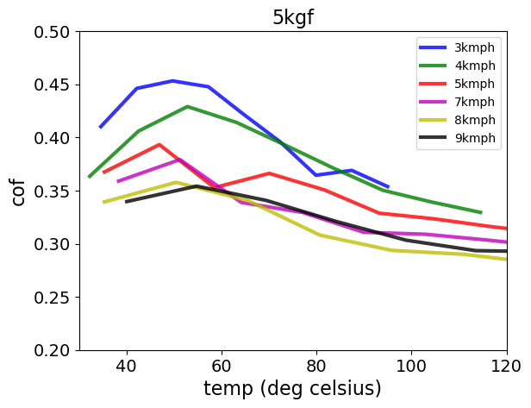
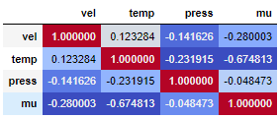
Co-relation matrix at fixed velocity
Lever force is constant but fluid pressure is varying with temperature. Is it possible to keep fluid pressure constant by controller?
Pressure has low effect on friction coefficient as it is a material property. Temperature can affect friction coefficient. This needs to be validated

Slide 3
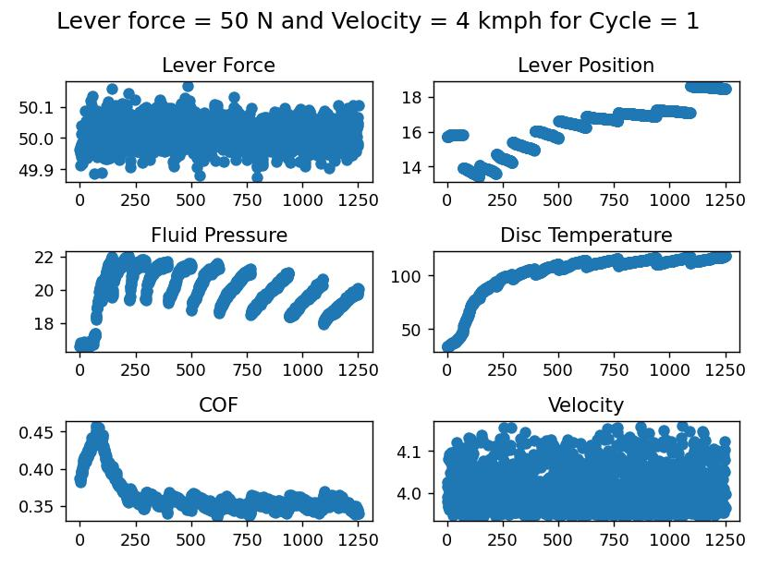
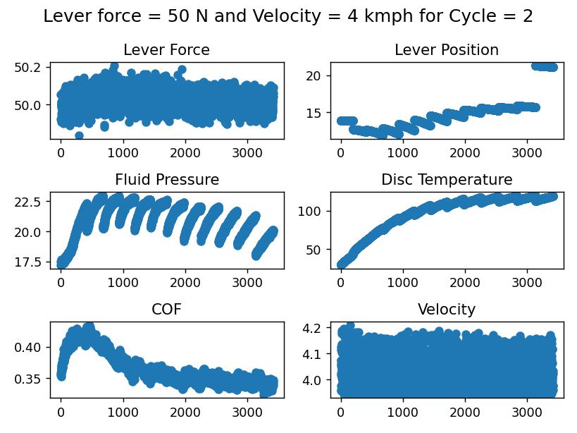
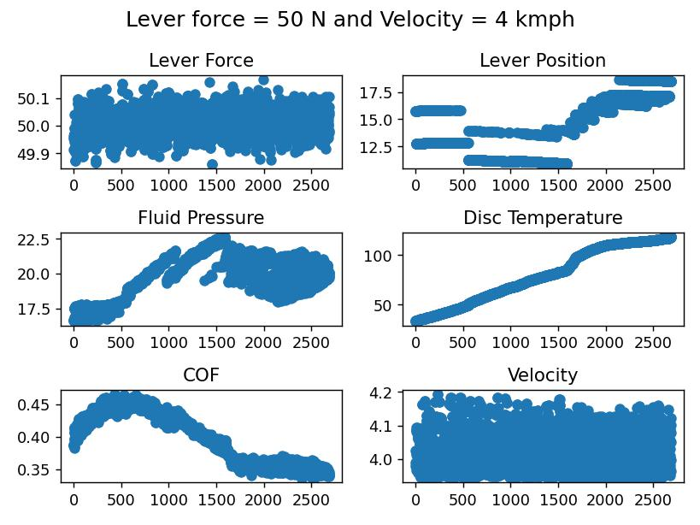
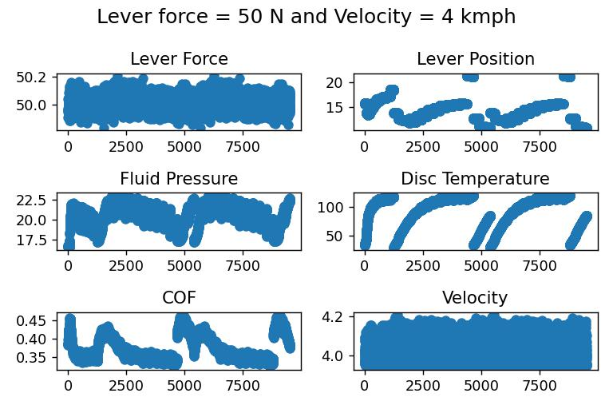
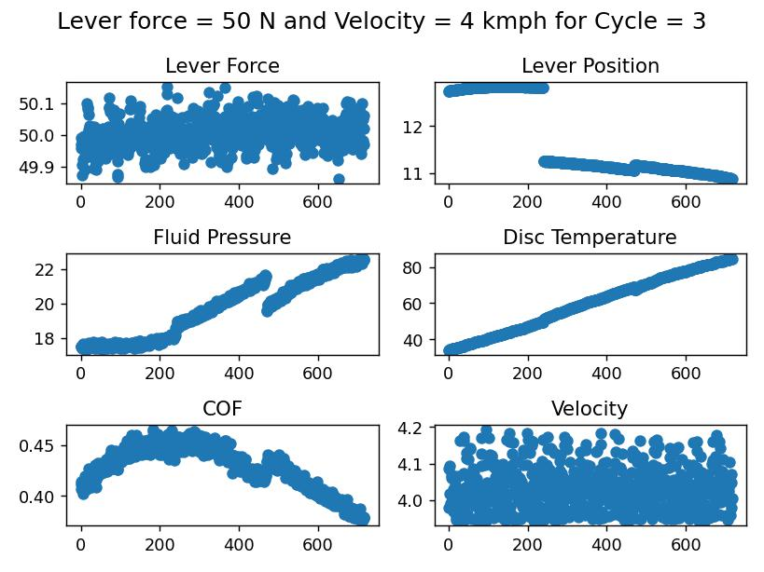

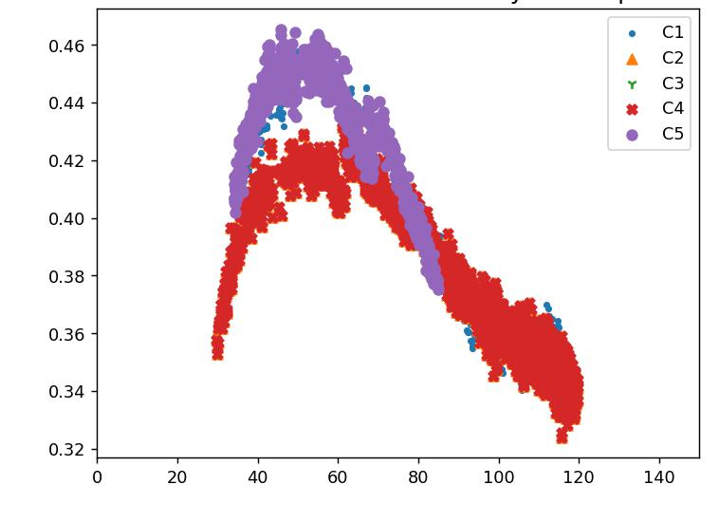
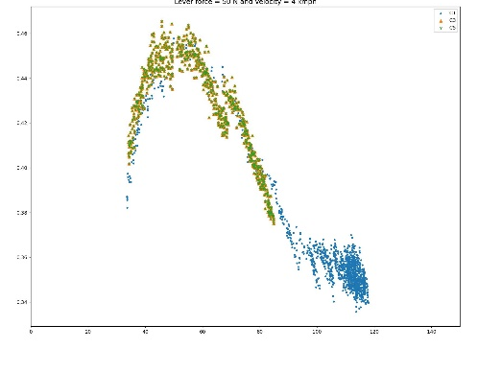

Cycle Splitting algorithm is written for splitting the raw dataset
Faulty cycles were removed manually as each cycle had different error. Generalized code is not possible due to the way the measurements were carried out.
Collated Data
Multiple Cycle data was collated in one Dataframe
Data was arranged in the increasing value of temperature for further processing
Before
After

Slide 4
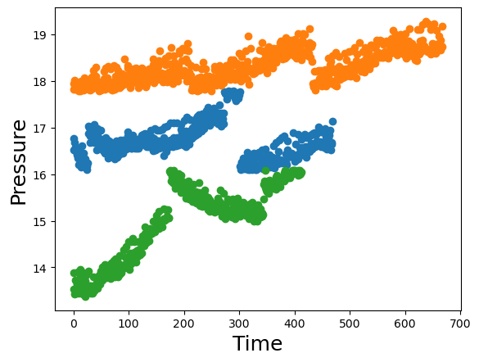
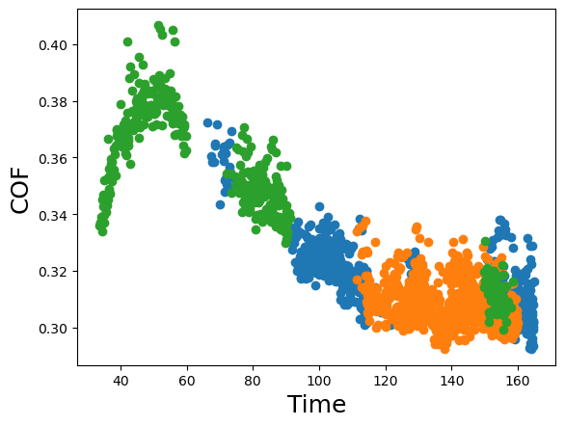
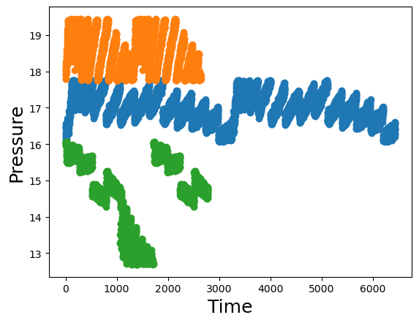
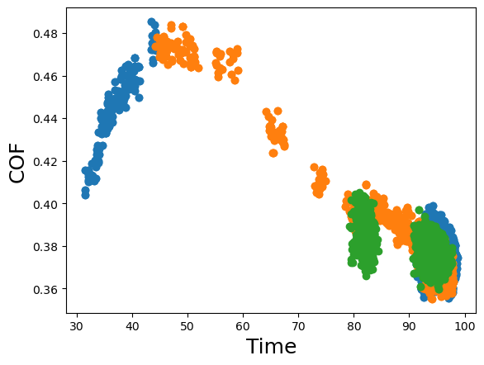
V = 10 kmph
Although the pressure is different the Coefficient of Friction varying mainly due to temperature change
The input lever force governs how fast the temperature changes. At high lever force the temperature rise is high. This could be possible reason in panic brake condition.
V = 10 kmph
V = 6 kmph
V = 6 kmph
Co-relation matrix at fixed velocity

Slide 5
